Slide 1

ICP-Presentation Two
Venkata Naga Sai Srikanth Gollapudi
Mangi Varun Reddy

Slide 2
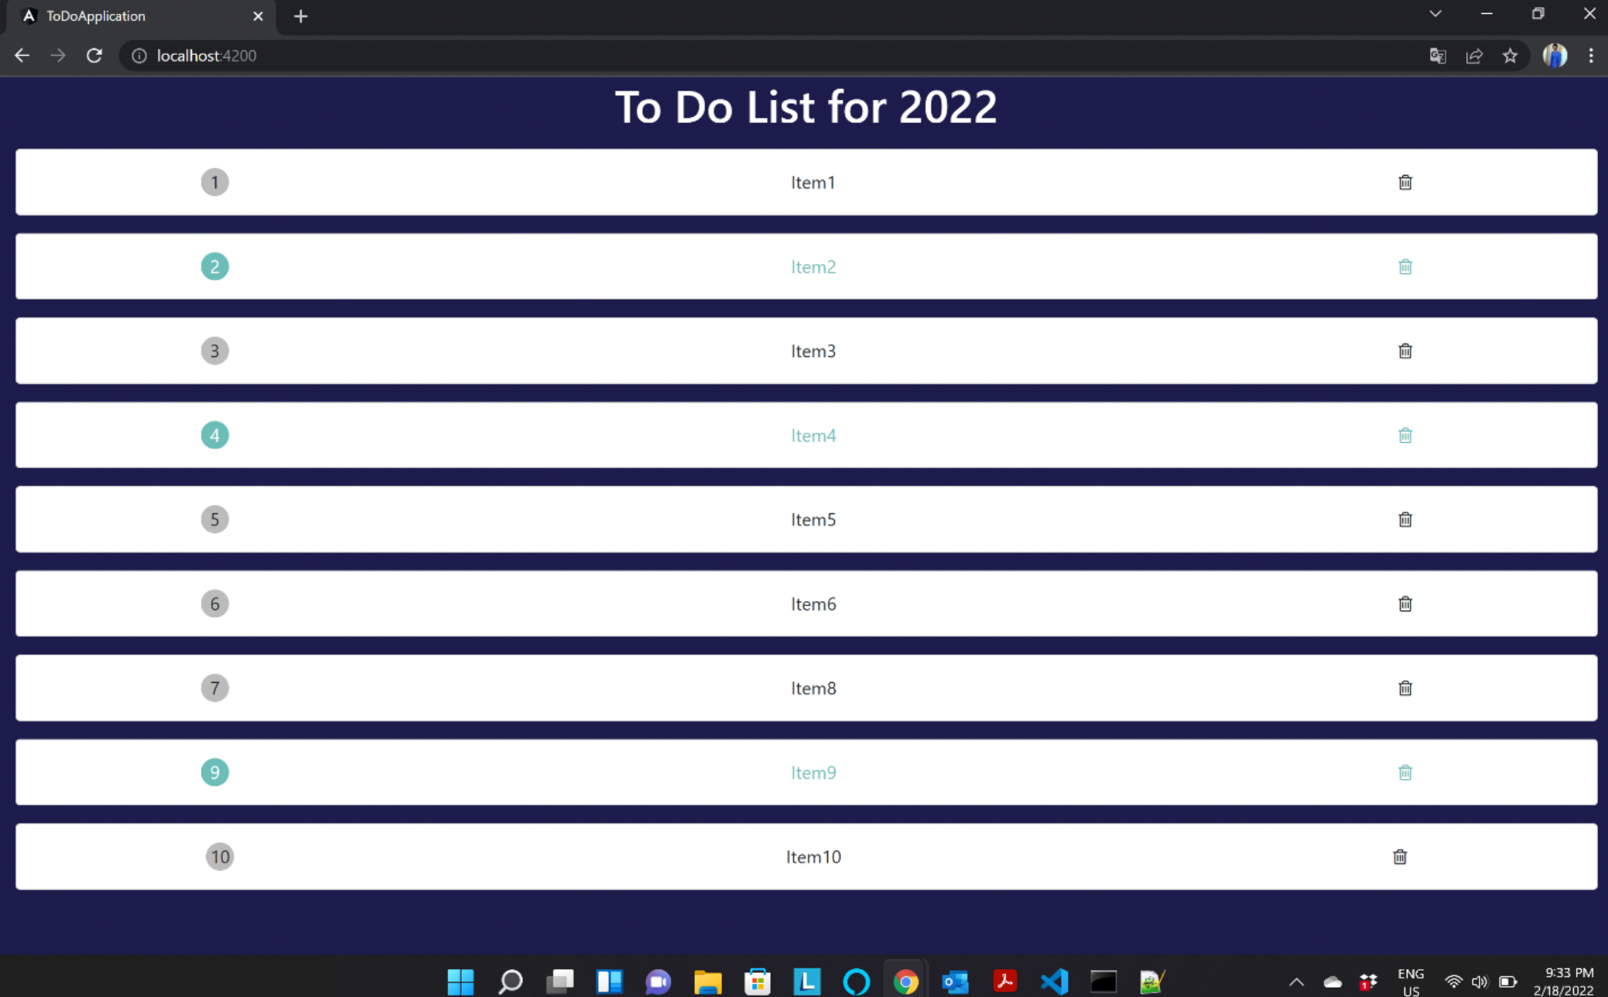
To-Do Application
Created an angular project for to-do-application
Using the Bootstrap framework created a container for the mockup.
used cards to show the to do list of items.

Slide 3
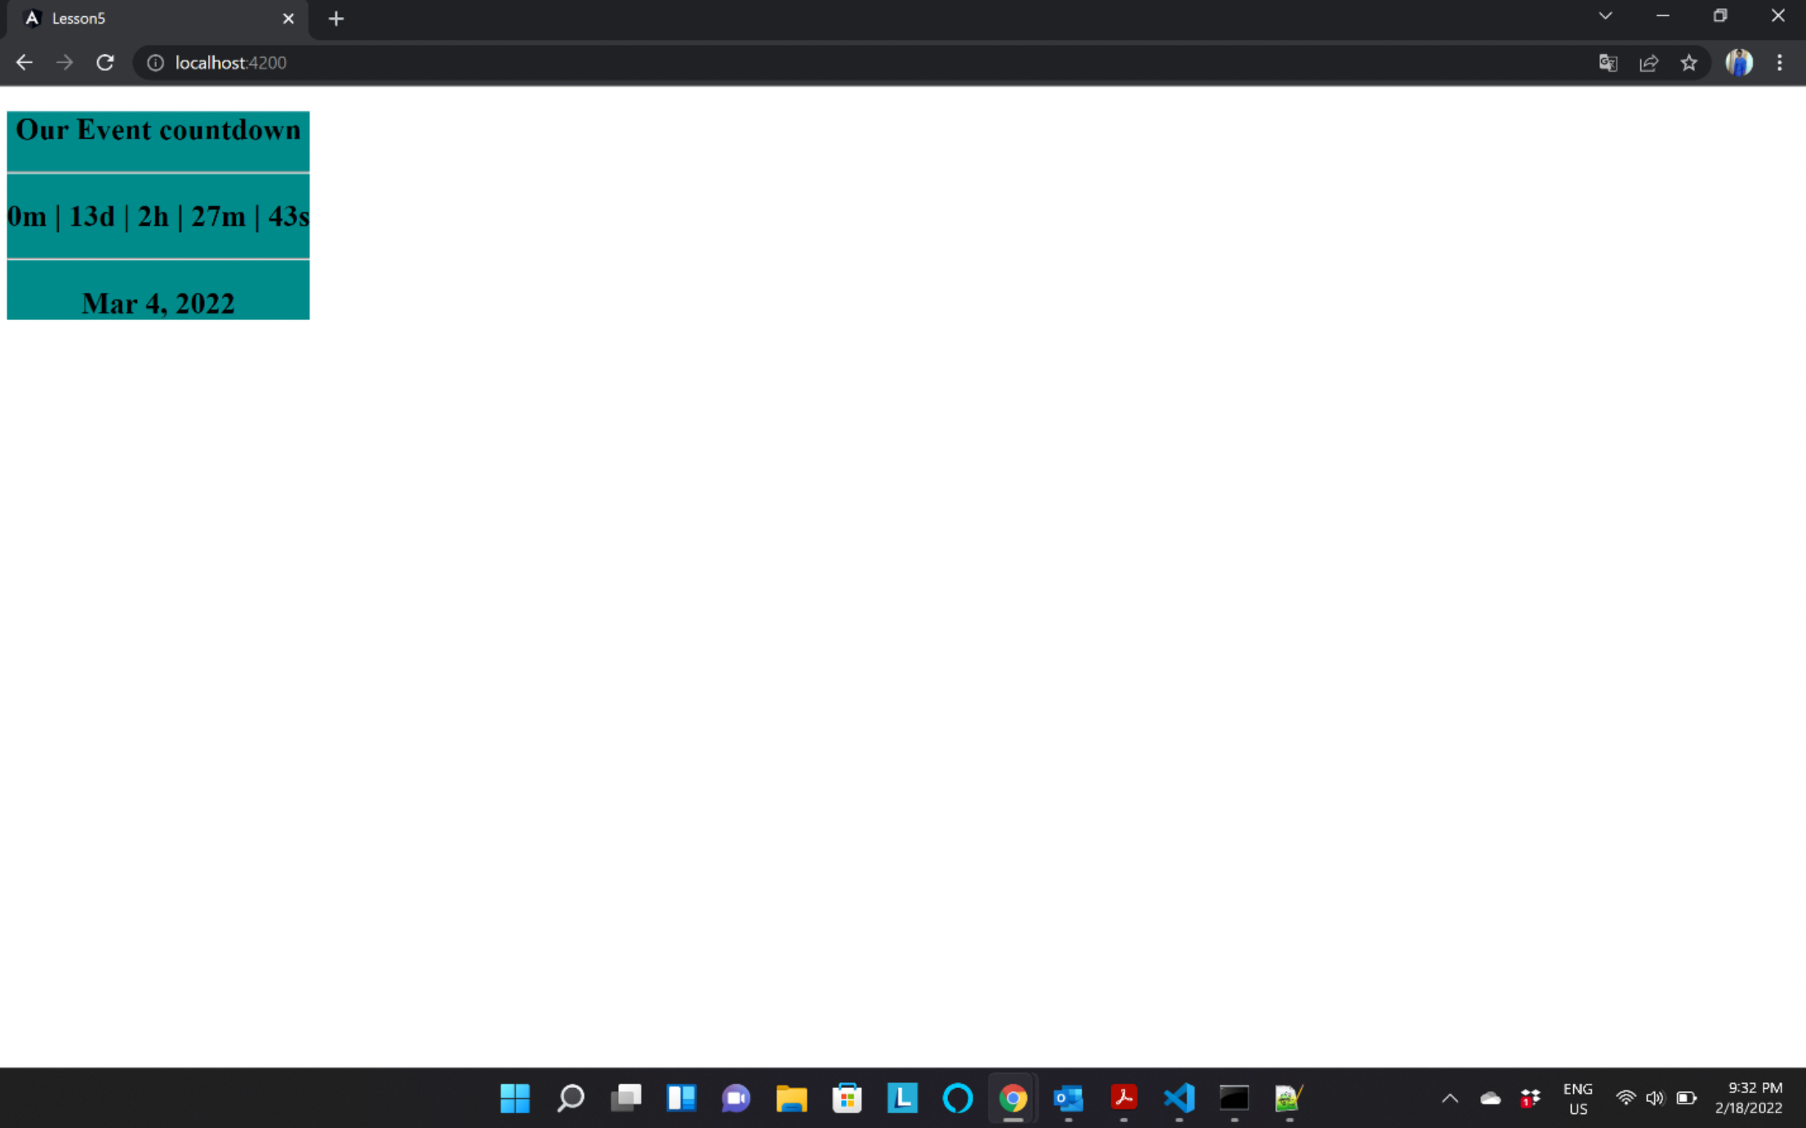
Event Countdown
We have used Date api an set Interval Api which we used to set the timer for the event.
The logic behind the countdown date is that we are taking the event date in the date variable.

Slide 4
Call-Api
Created an angular project named call-api, where we need to integrate the foursquare api and edamam api for nearby and recipe search.
Used the Bootstrap framework for responsiveness of the page.
Used cards, *ngIf.
On click of search button in the page it calls the getRecipie function where it captures the query and sends it to the service

Slide 5
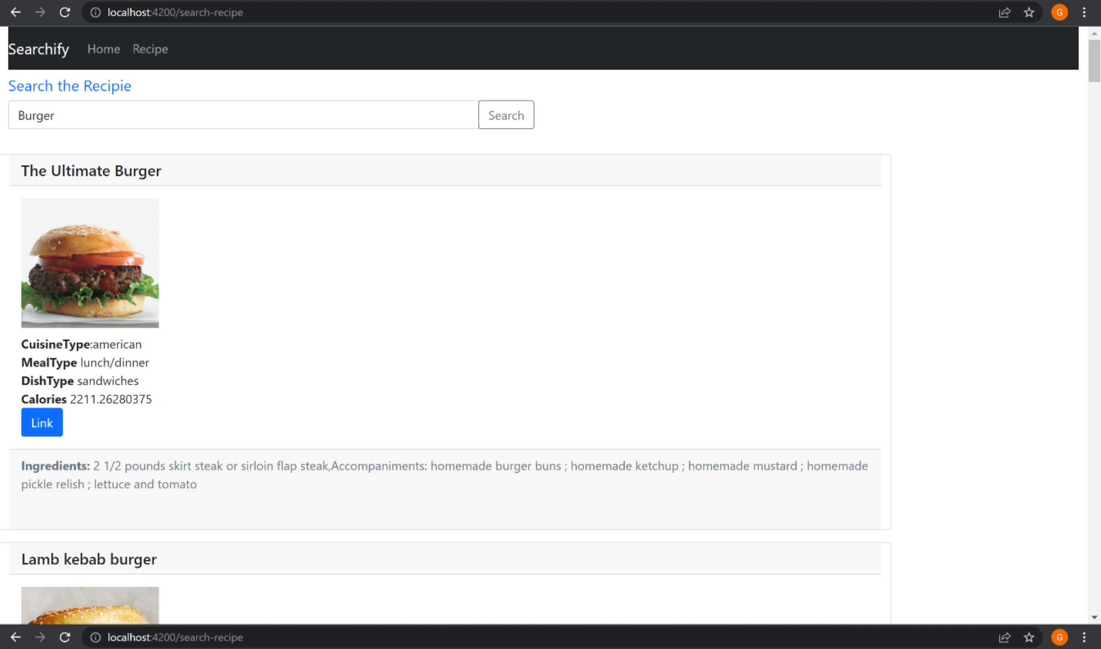
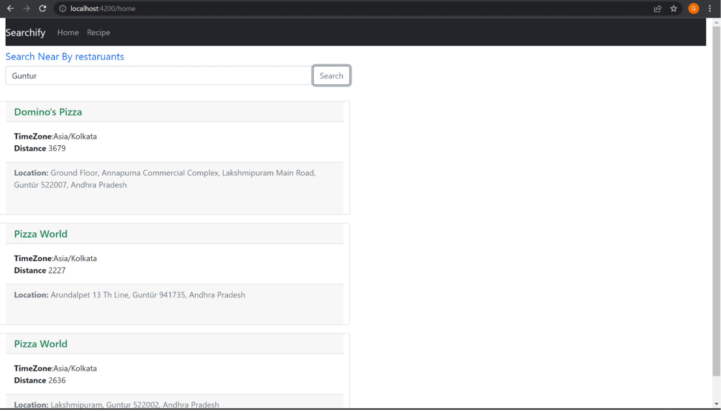
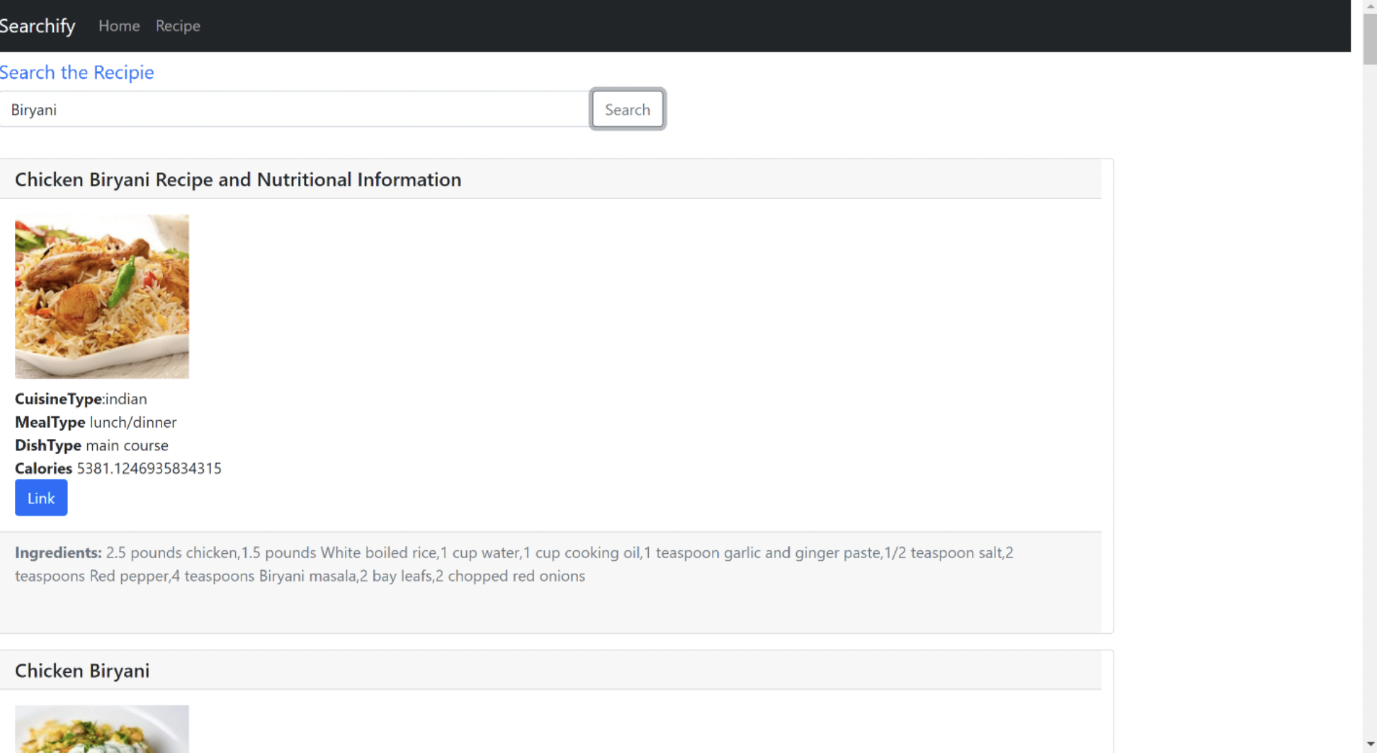
Searching for a Recipe
Nearby Restaurants

Slide 6
Login Page with validation
Created an empty project in the Android Studio and installed emulator of Google pixel 5 with Android OS version of 12.
design the user interface nothing but a login page which consists of Username and Password fields with a login button.
A user will be successful in logging into the application when the username and password provided by the user are Equivalent to each other.
When the username and password are incorrect then an error message is displayed saying that “Username/Password is incorrect”

Slide 7
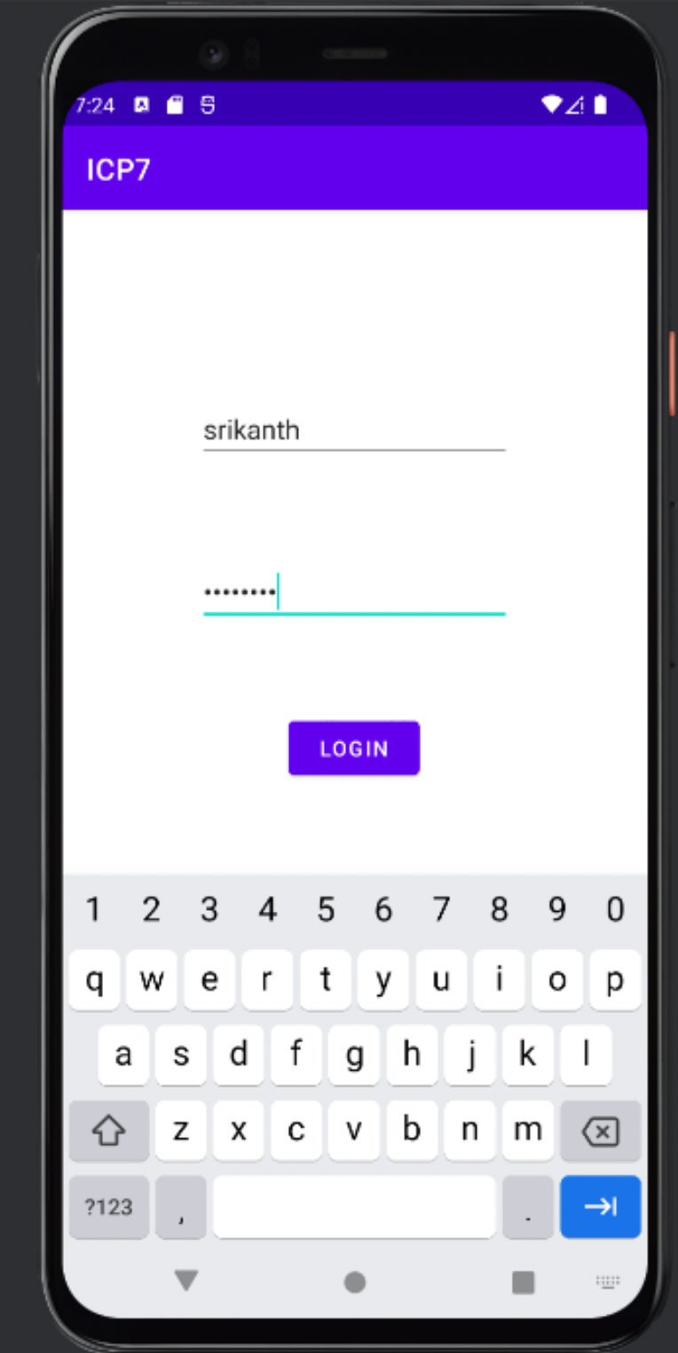
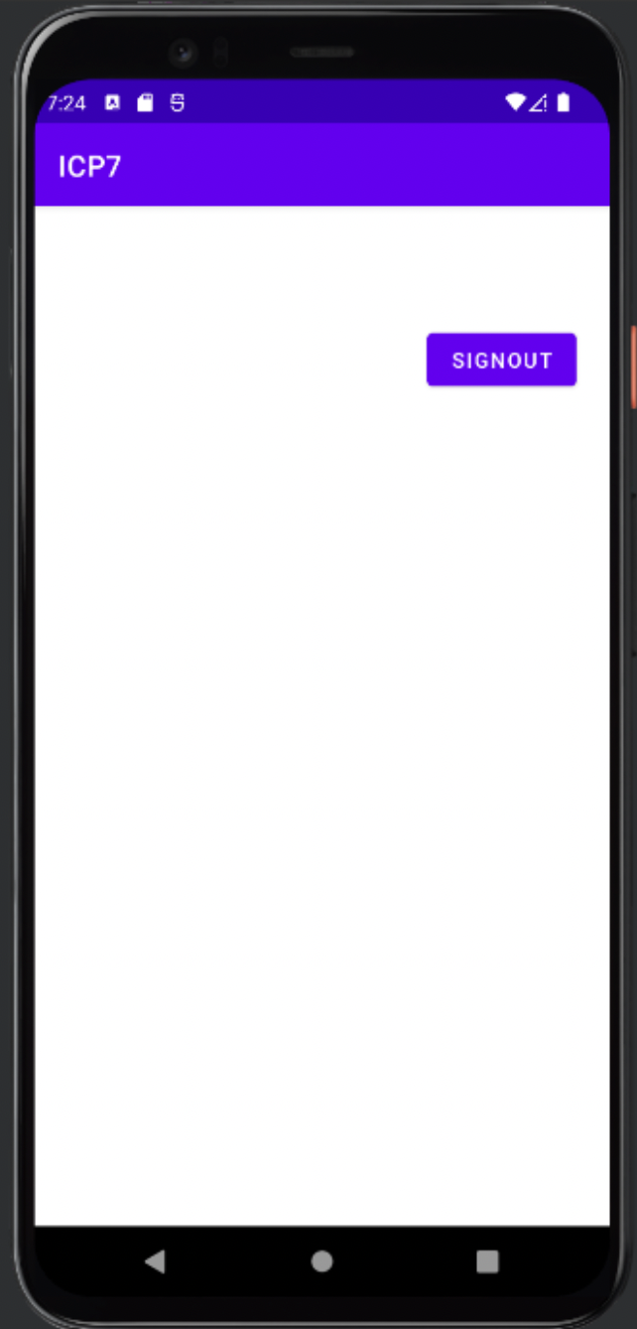
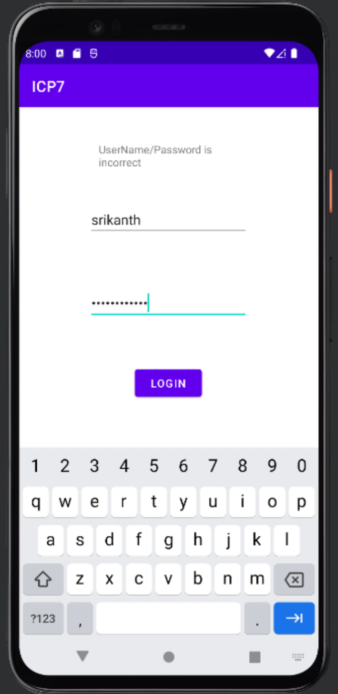
Entering UserDetails Sign-out button User entering wrong details

Slide 8
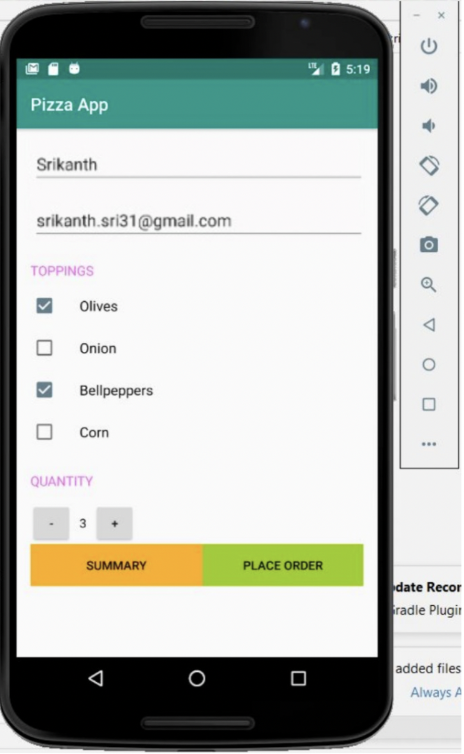
Pizza Application
Created a pizza ordering application.
Functionality,
Selecting pizza toppings
Quantity
Place order
Summary

Slide 9
Summary page

Slide 10
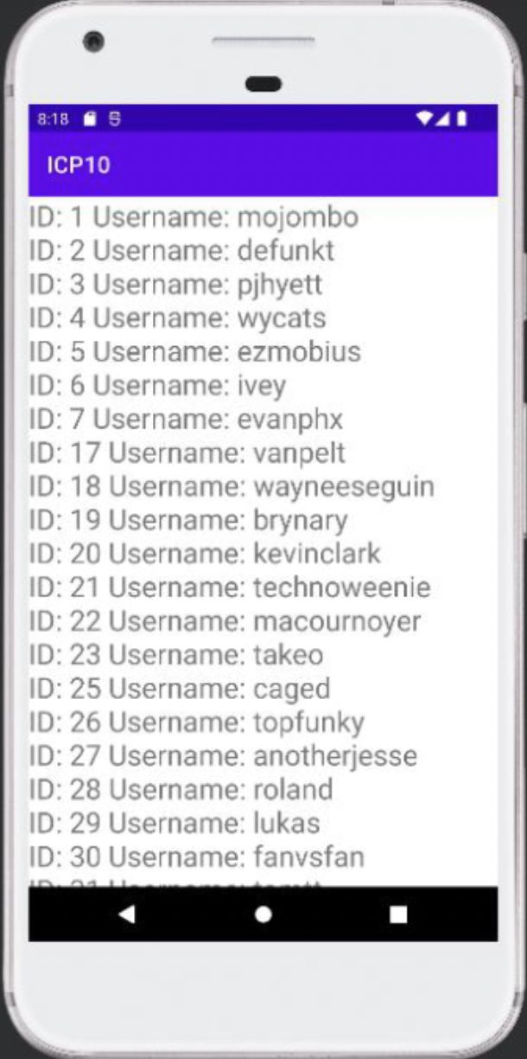
Consuming the Rest Api
created a new java class file with the name User.java which acts as a data transfer object which consists of id and username with getters and setters.
In the onCreate function in the MainActivity.java,retrofit api is used consumed the github rest api to fetch the users data.
On Successful call of api, response is collected in the onResponse method and casted to User class which is collected in the list. Then it is displayed to the user.

Slide 11
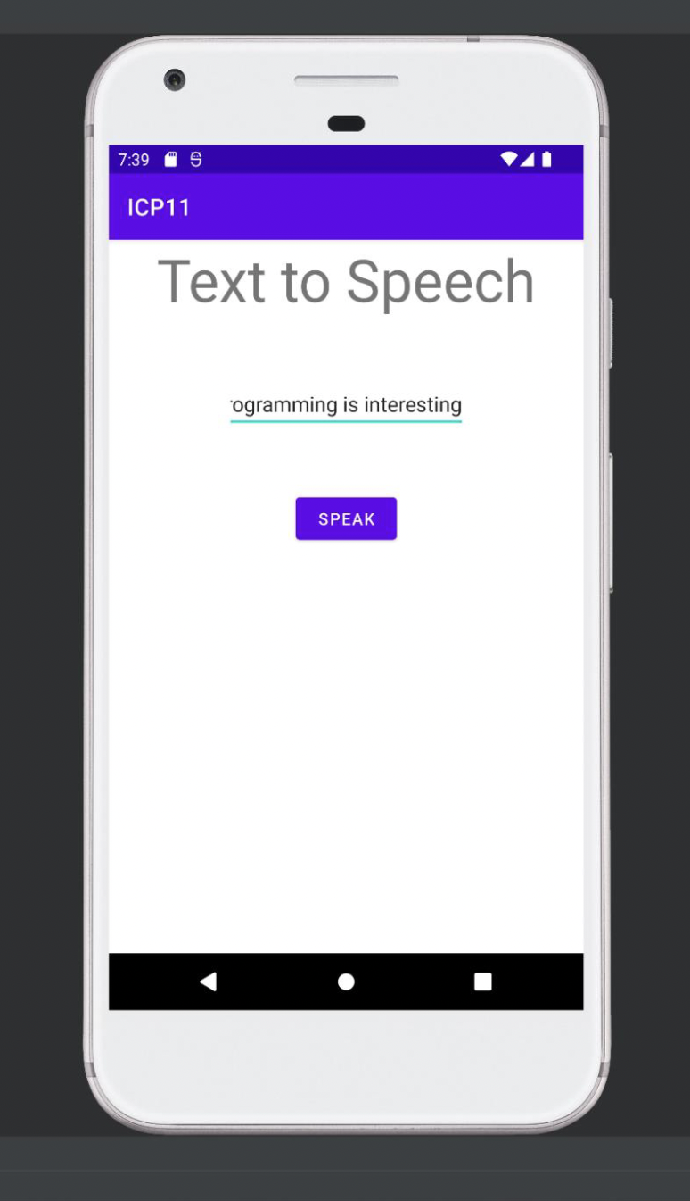
Text to speech
Added textview, edittext and button in the mainacitivity.xml with id provided to each of the tags.
Onclick of the button an event listener is added where here the text to speech conversion takes place
Text to speech (android built in package) is used for conversion process.
Text to speech is an api provided in android built in package where on Success it takes English locale and then conversion process starts.
speak method is used to convert the text to speech and results in producing speech as output.

Slide 12
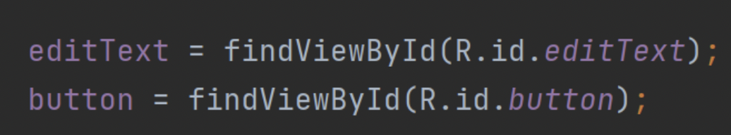
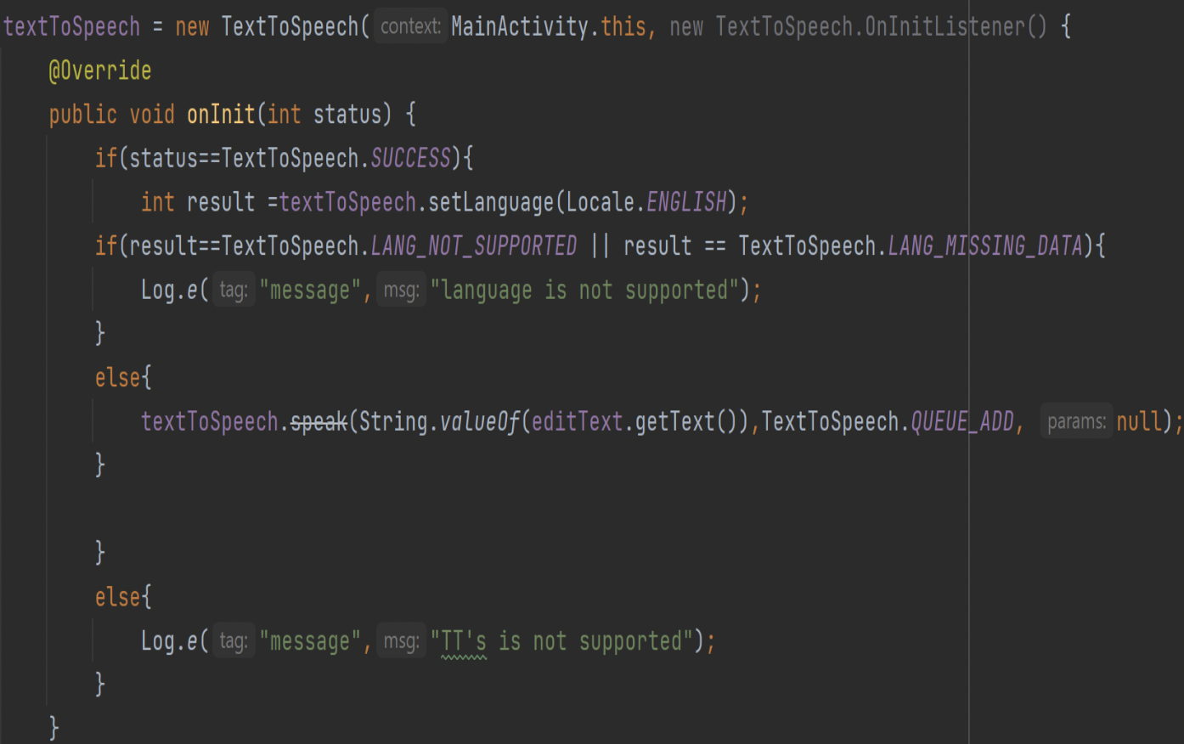
Fetching the data using Id’s
Text to speech logic which handles error and success scenario’s

Slide 13
Thank You

